Slide 1

Analysis of Data Play Reviews: Word Frequency and Cloud Visualization
Email :gokul11sm@gmail.com
Name : Gokul S

Slide 2
Contents:
Challenges Overview
Overview of Data
Tools and Resources Utilized
Methodology: Frequency Analysis
Methodology: Visual Word Mapping
Word Cloud using Power BI
Insights: Word Cloud Results

Slide 3
Challenges Overview:
Data Play, an educational technology company, is dedicated to providing students with skills that are ready for the industry.
To assess the quality of its services, the platform has compiled Google reviews. • The reviews were gathered, processed, and organized into an Excel spreadsheet.
This dataset contains the names of reviewers, their ratings, and the content of their reviews.
The objective is to analyze whether the feedback indicates positive or negative sentiments.

Slide 4
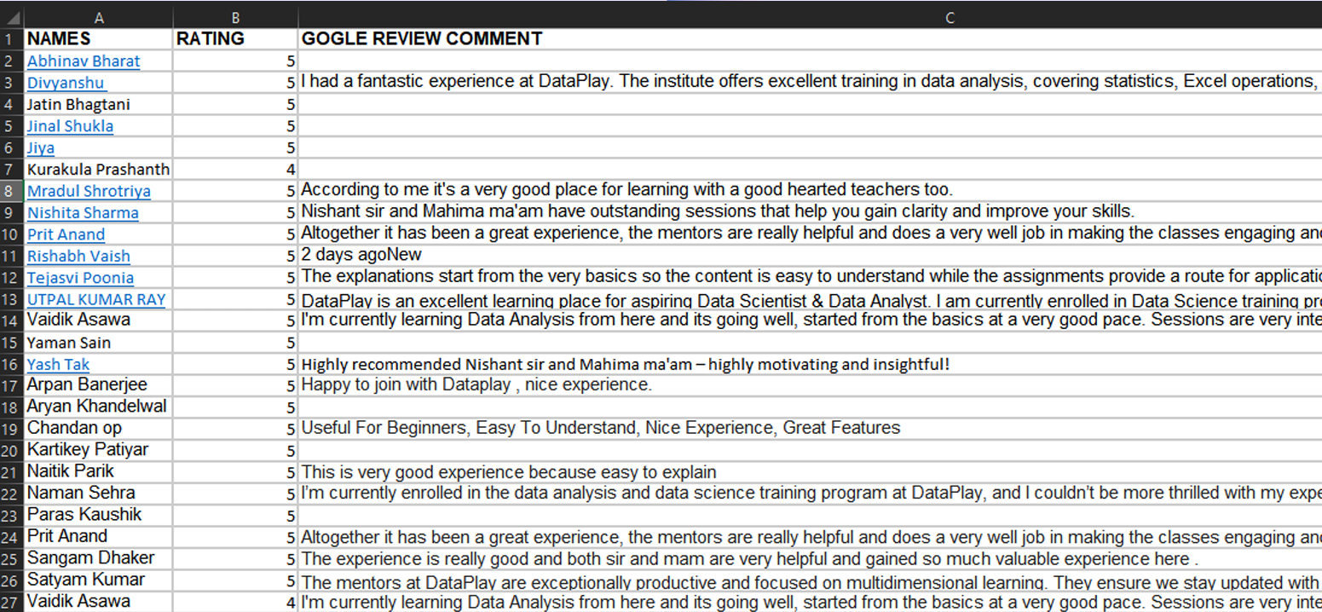
Overview of Data :

Slide 5
Tools and Resources Utilized:
Use the "Text-to-Columns" feature to split text into separate columns based on a delimiter (e.g., space).
Apply the "TRIM" function to remove unnecessary white spaces before and after the text.
Utilize the "UNIQUE" function to extract distinct terms from the dataset.
Employ the "COUNTIF" function to determine the frequency of each unique term within the text range.
This combination of functions streamlines text analysis in Excel.
We use Excel for count vectorizer and adds-on on Excel for Word Cloud.

Slide 6
Frequency Analysis Methodology :
To create a dictionary of terms with frequencies from a review text, follow these steps:
Split the Text: Separate the text into individual words using delimiters like spaces or punctuation.
Consolidate Words: Combine all words into a single list.
Trim Spaces: Remove leading or trailing spaces around each word for uniformity.
Identify Unique Words: Extract unique words from the list to eliminate duplicates.
Count Occurrences: Determine how many times each unique word appears in the text.
Create a Dictionary: Compile the unique words and their frequencies into a dictionary, with words as keys and their counts as values.

Slide 7
Word Cloud Creation Process
Imported the feedback dataset into Excel Add-ons.
Selected the description column as the data source for word cloud visualization.
Used the Word Cloud feature in Excel Add-ons.
Removed common “stop words” to highlight meaningful terms in reviews.

Slide 8
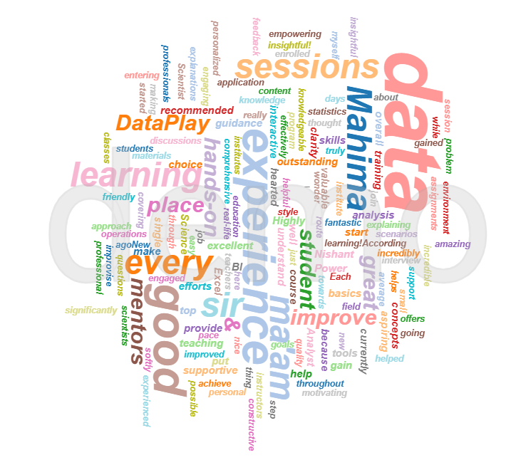
Word Cloud

Slide 9
Word Cloud using Power BI :
Step 1 - Import the Data :
▪ Open Power BI Desktop.
▪ Click on "Home" → "Get Data" → "Excel"
▪ Select your file and click "Load" to import the data.
Step 2 - Install the Word Cloud :
▪ Go to "Visualizations" pane in Power BI.
▪ Click on "More visuals" → "Get more visuals".
▪ Search for "Word Cloud" and click "Add" to install it.
Step 3 - Create the Word Cloud :
▪ Drag and drop the Word Cloud visual onto the Power BI canvas.
▪ Place reviews text column into Category field.

Slide 10
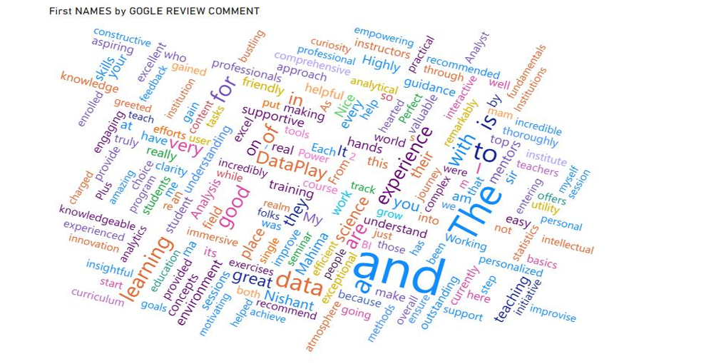
Google review Analysis By Power BI :

Slide 11
Thank You

